Slide 1


Slide 2
OpenMined is a community focused on building
open-source technology for the
decentralized ownership of data and intelligence.

Slide 3
Key Activities
Awareness: Raise awareness of the implications of Private ML
Tools: Lower the barrier-to-entry by building open-source tools
Community: We have really fun Hackathons…

Slide 4
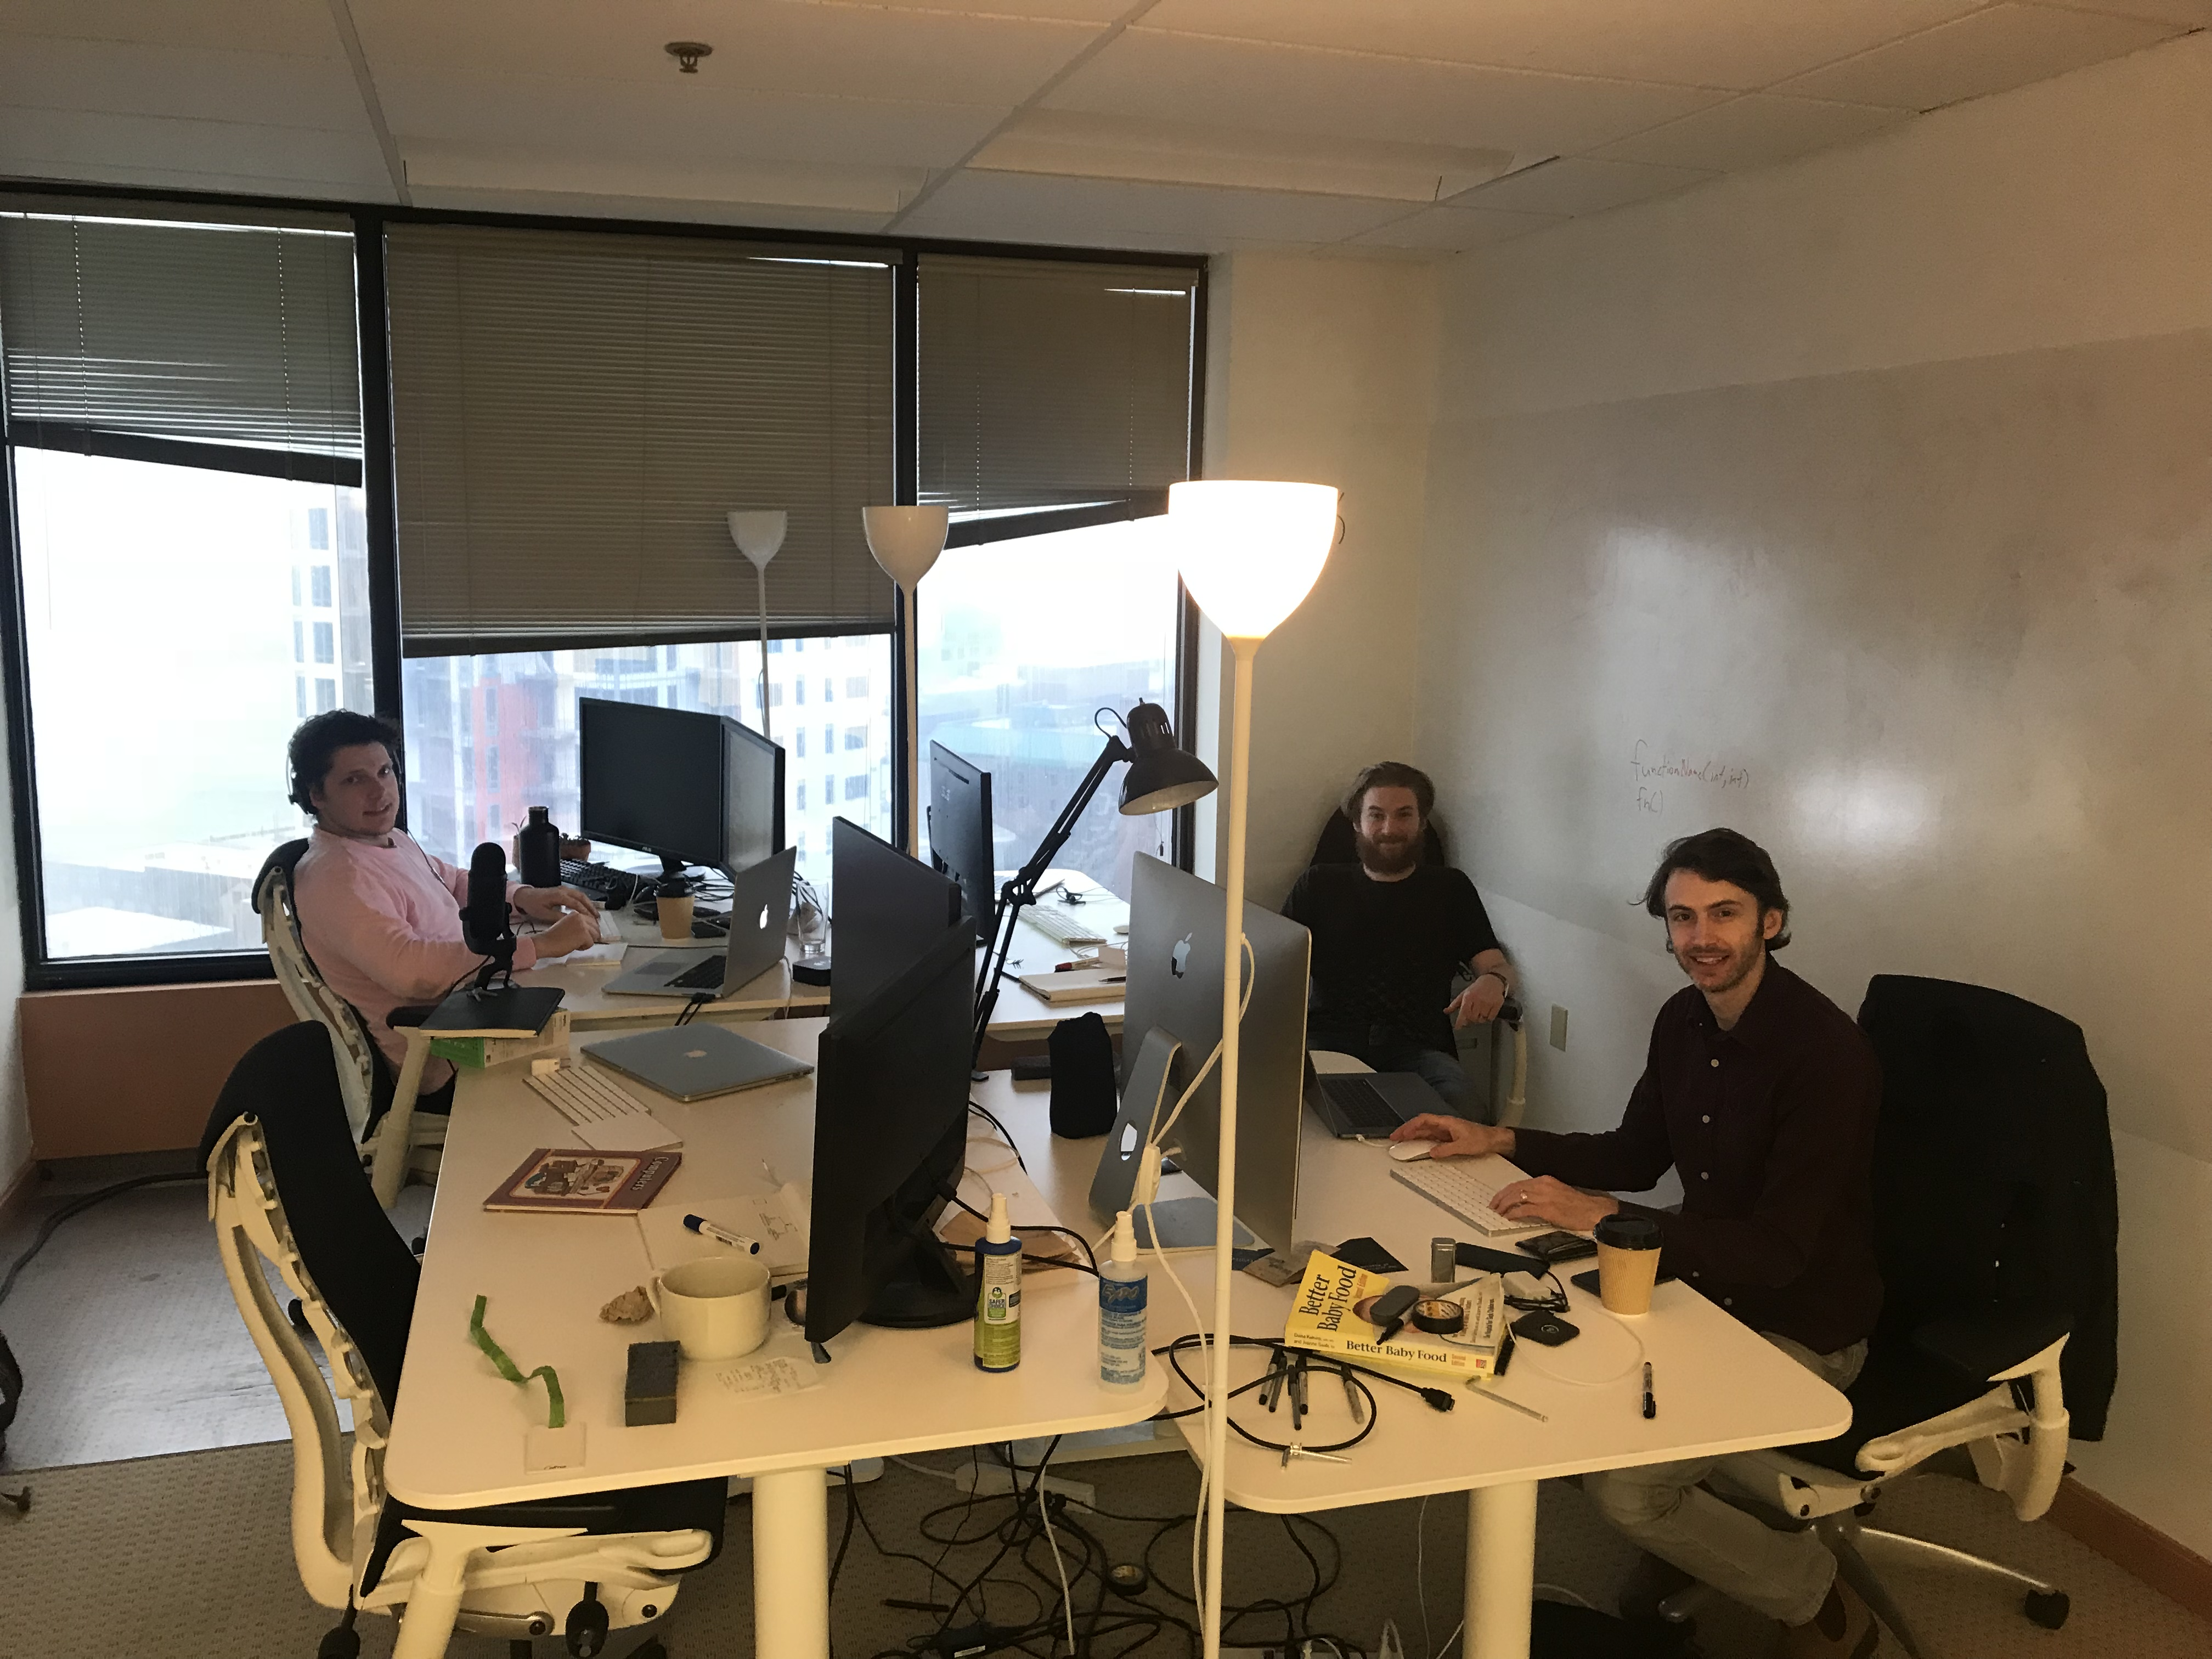
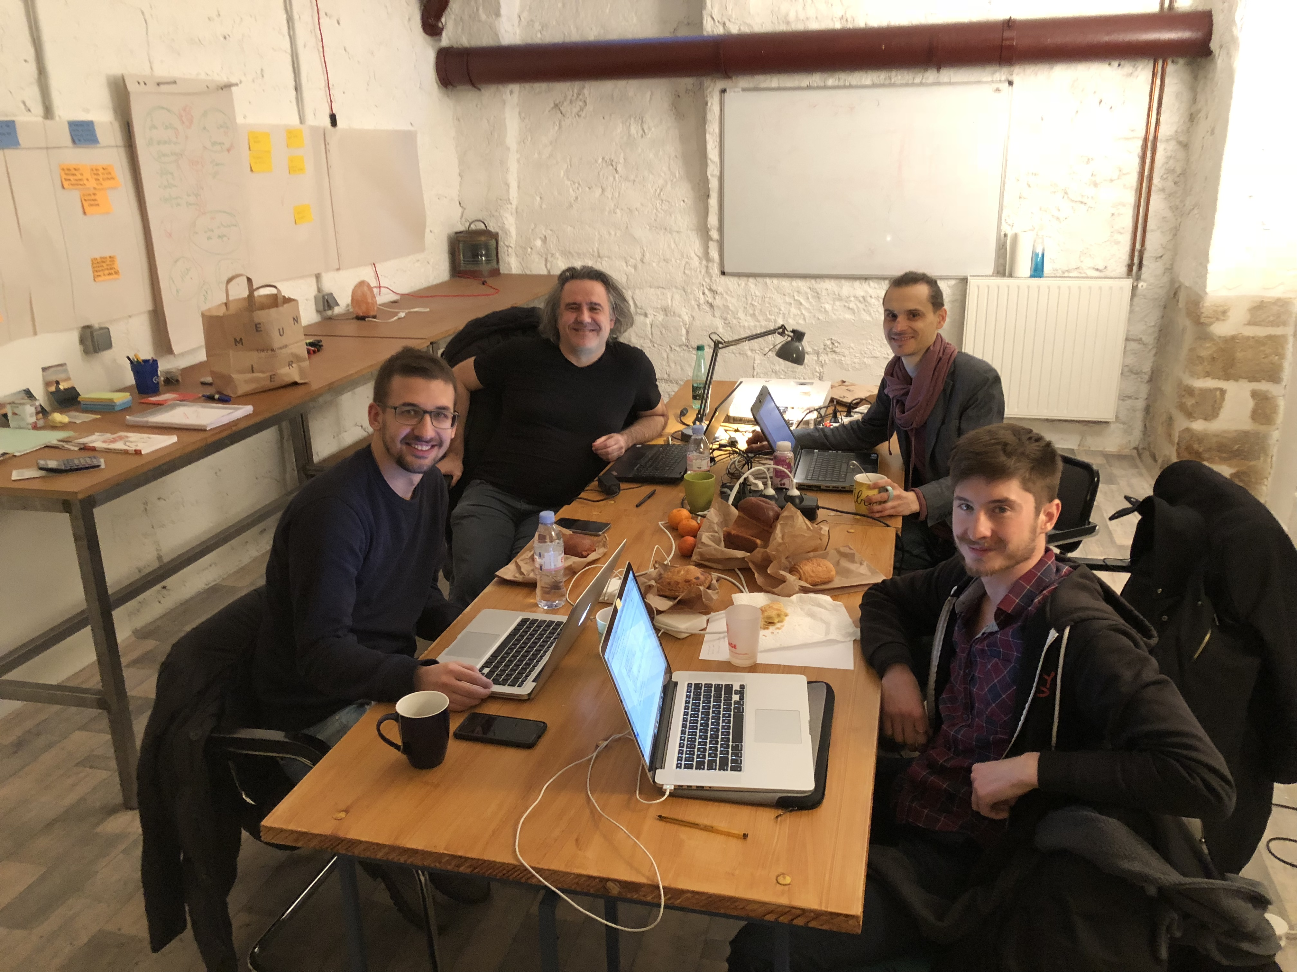
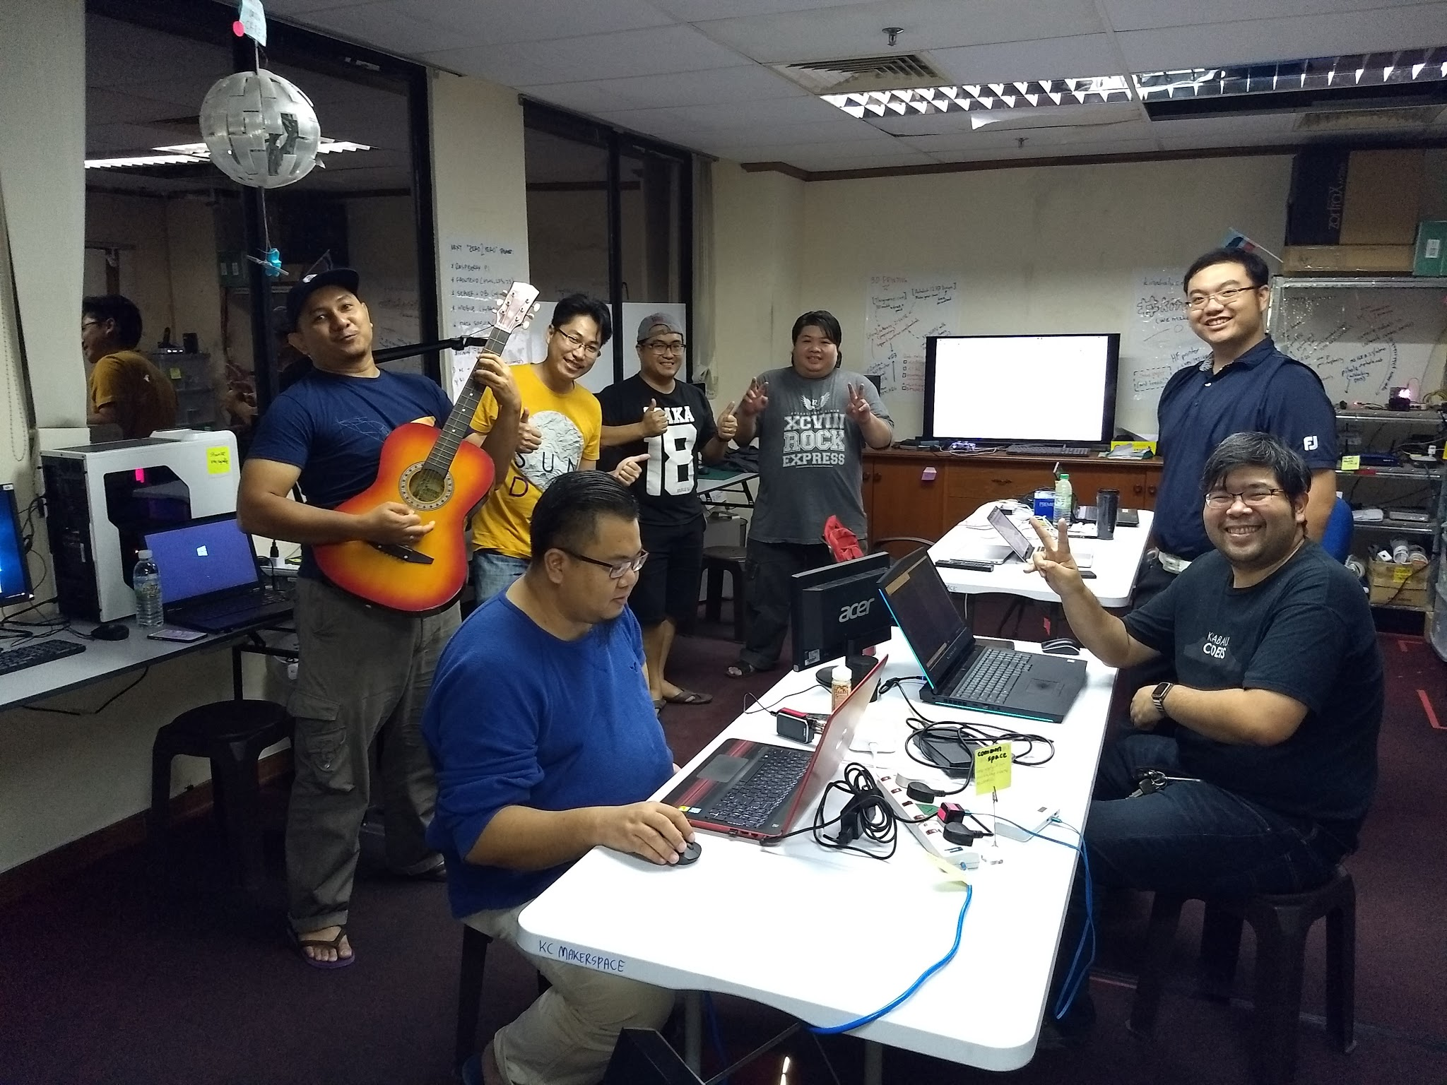
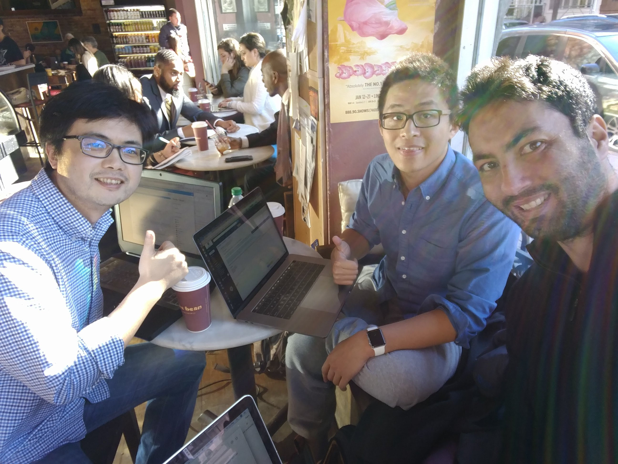
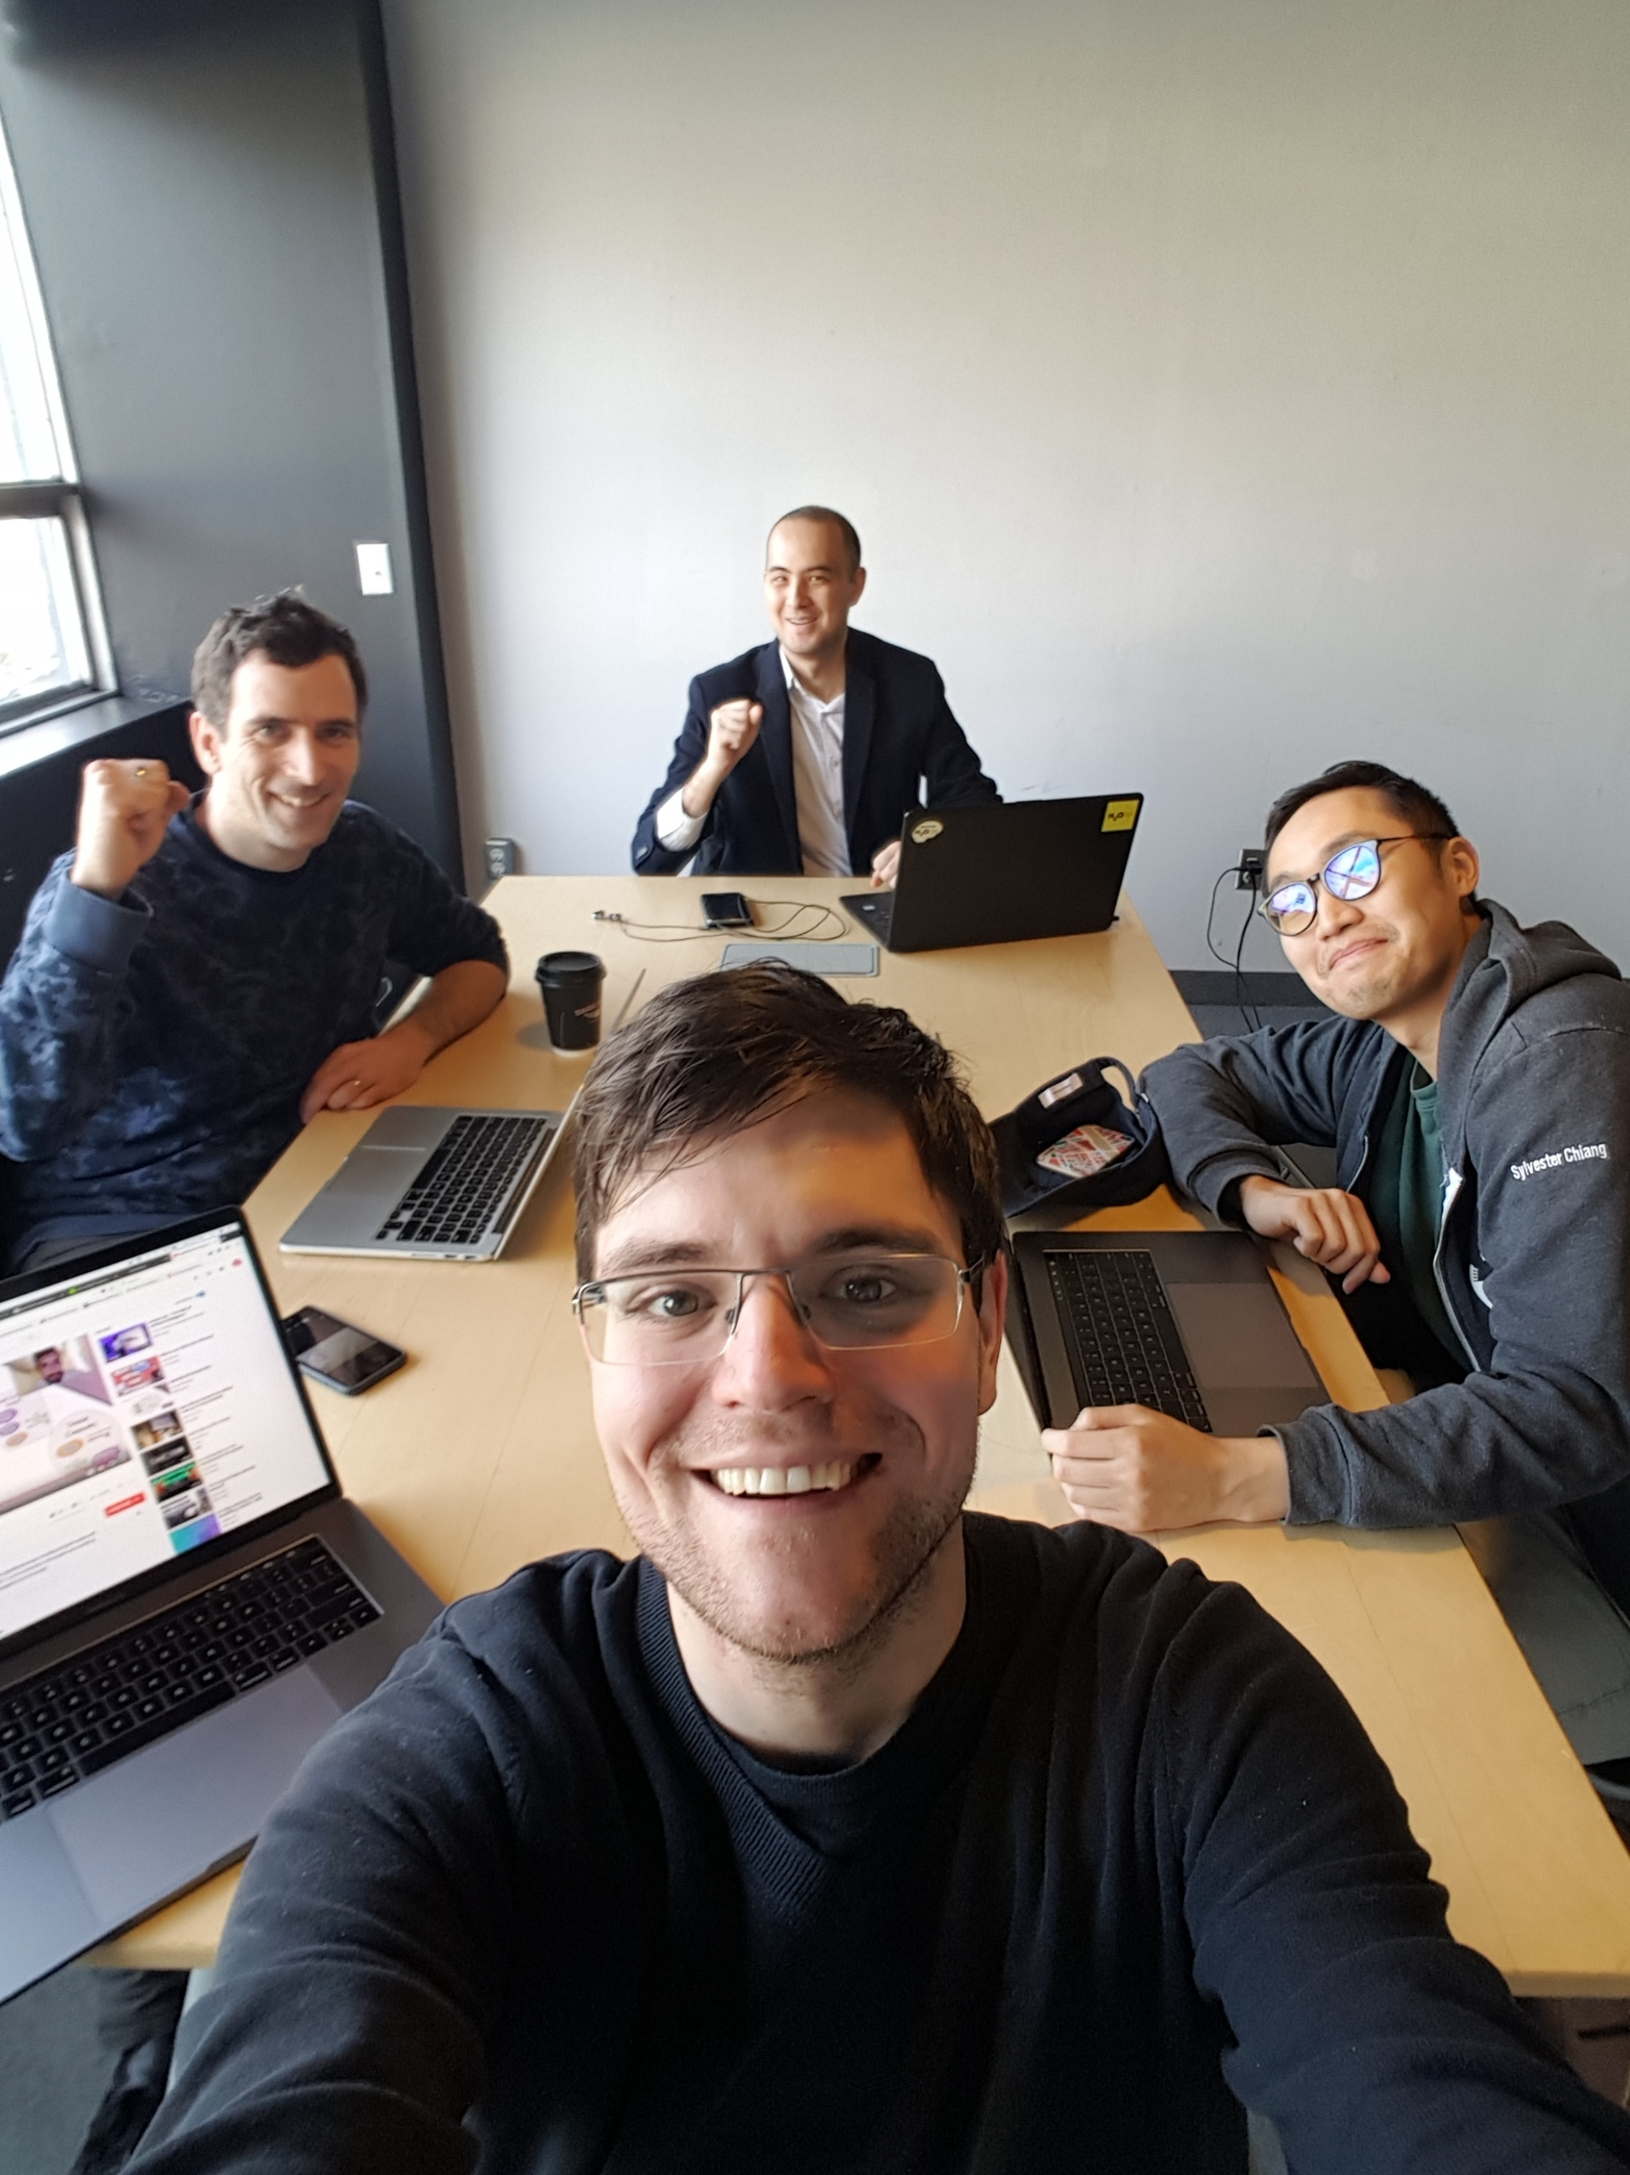
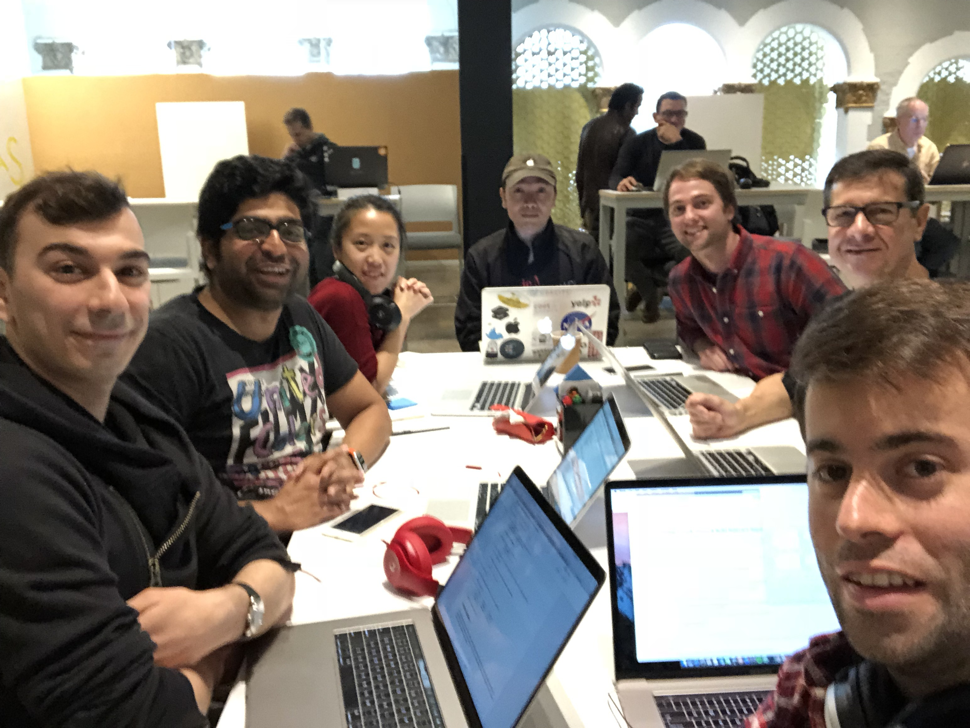
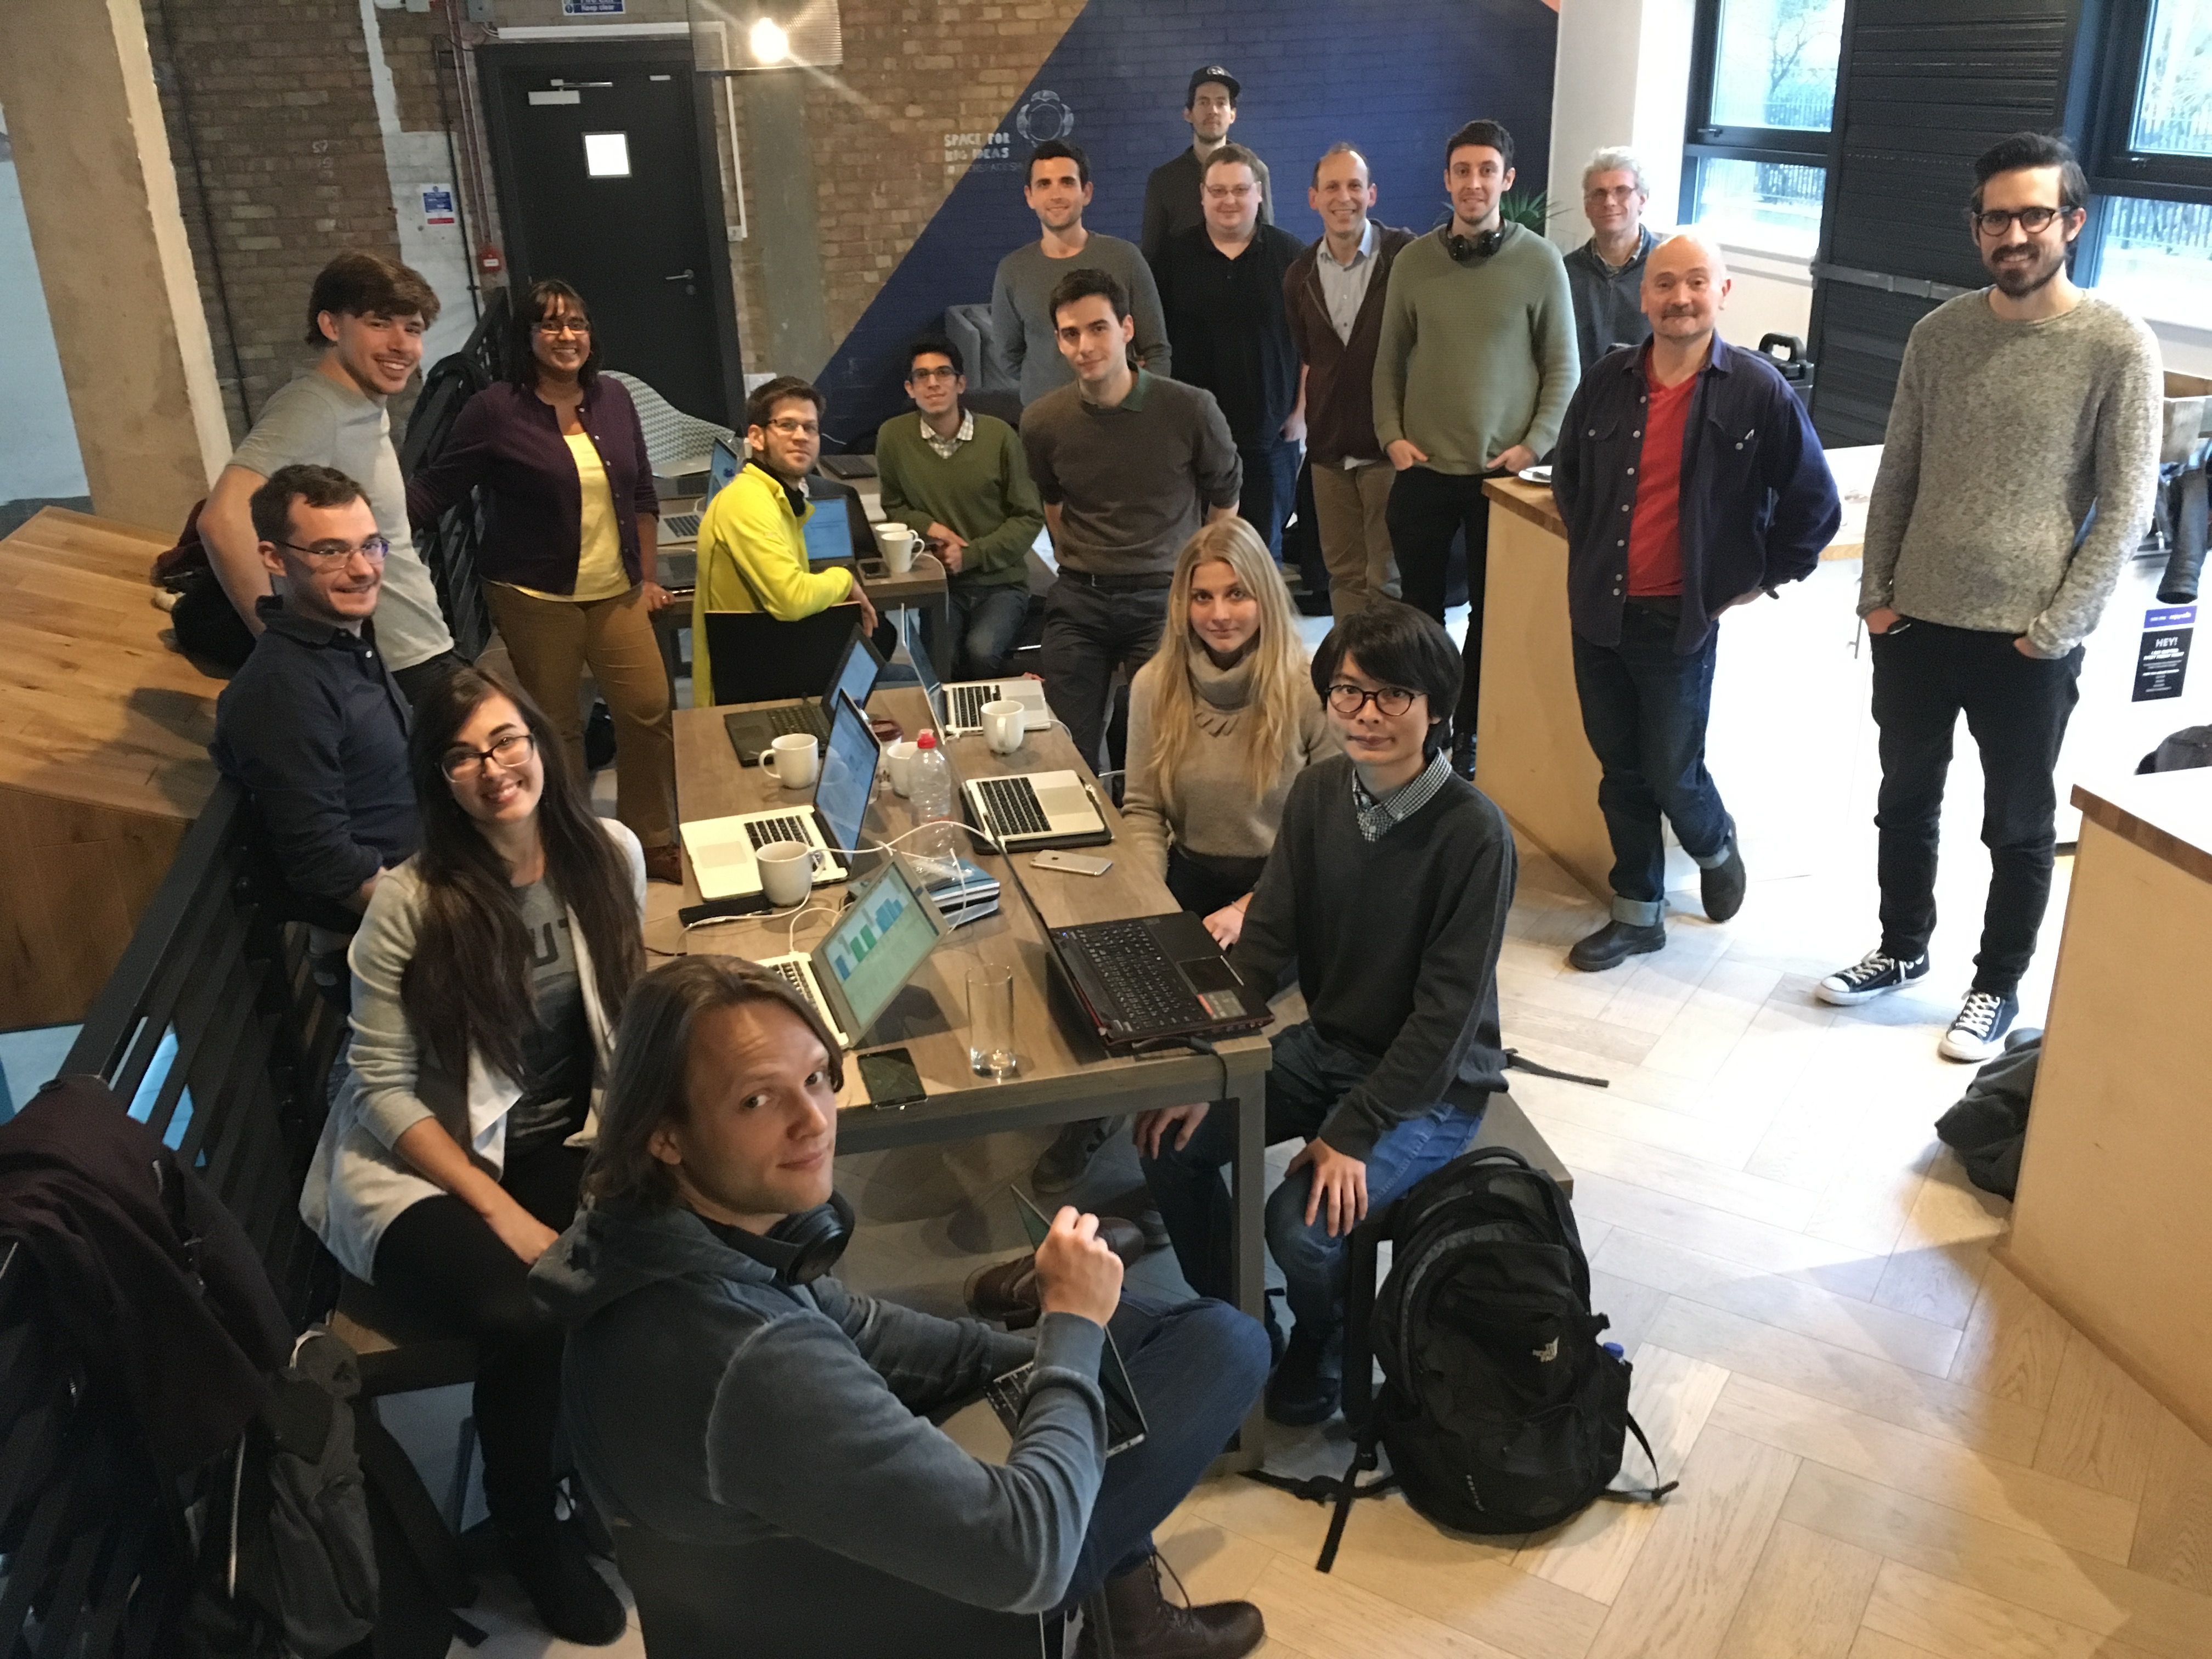

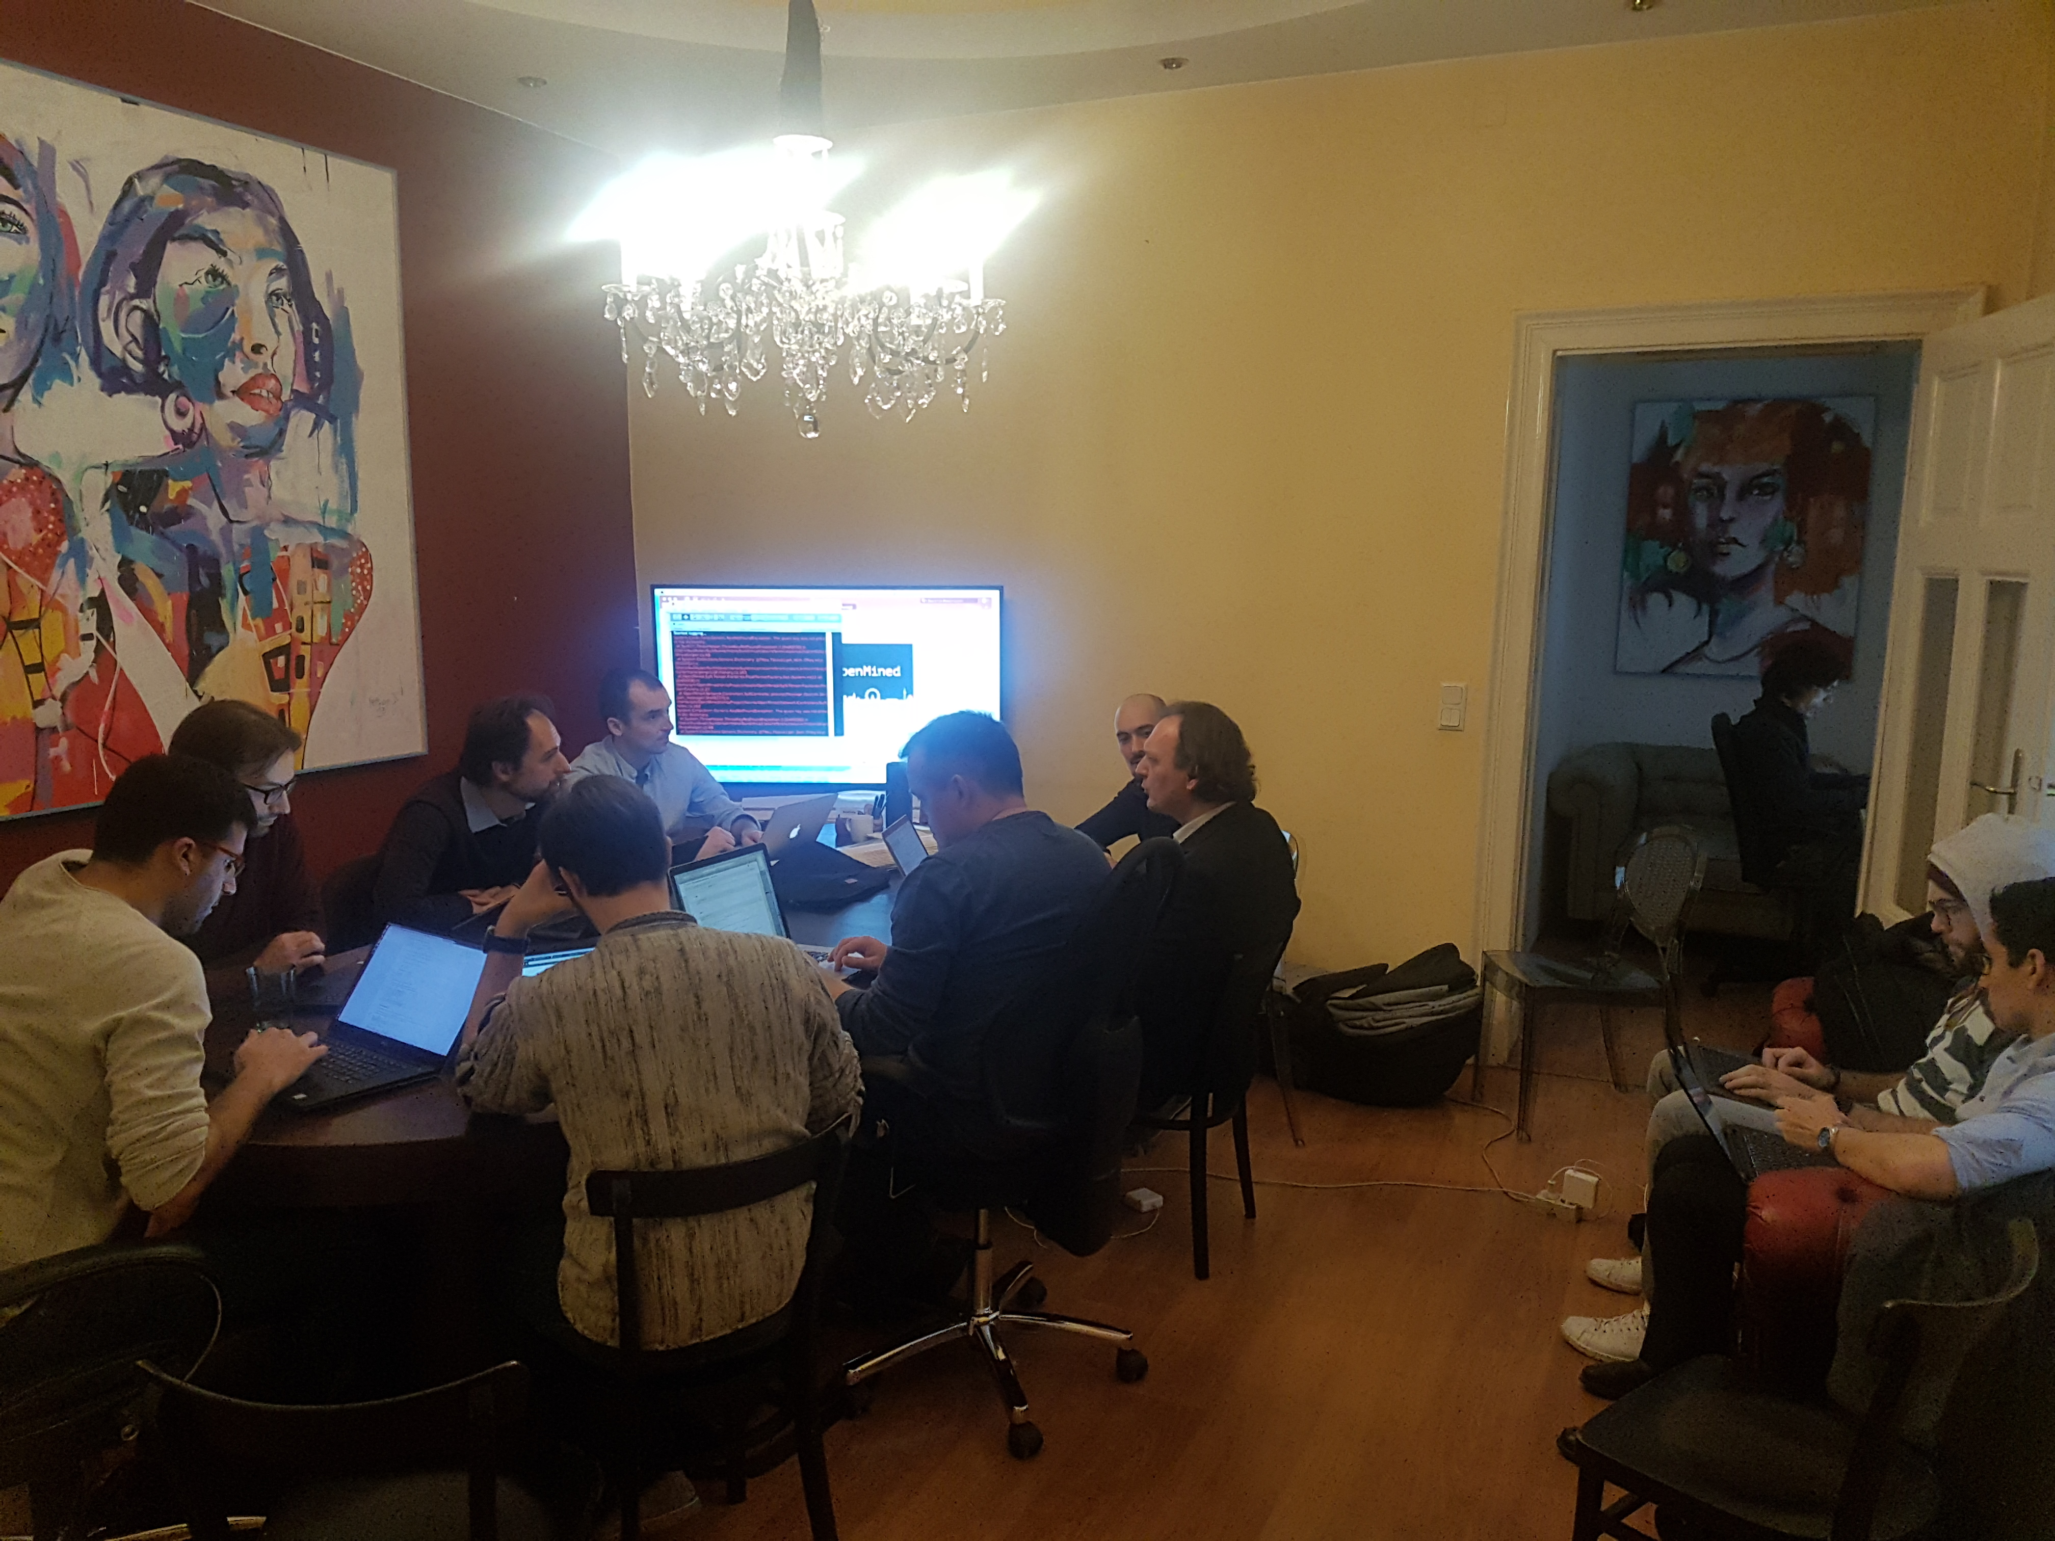
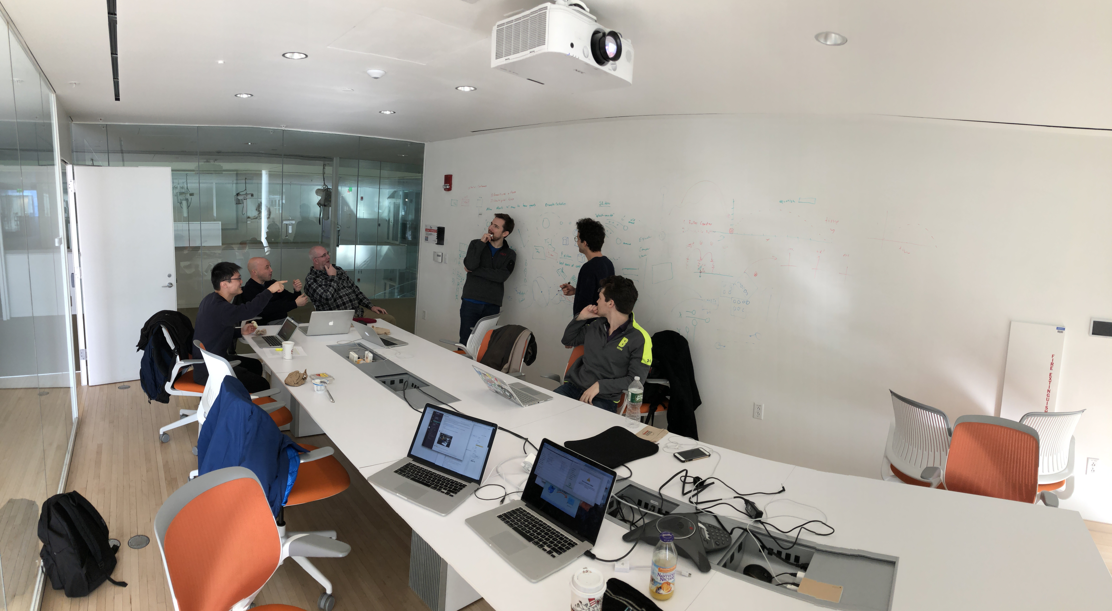

Slide 5
Outline
Why: the AI Business Model has privacy problems
How: an Introduction to the Core Technologies of OpenMined
Federated Learning
Multi-Party Computation
Gradient Marketplace
Roadmap

Slide 6

AI Inc.
The AI Business Model

Slide 7
Social App
AI Inc.
Jane’s Data
Jack’s Data
Joe’s Data
1. Acquire Data about People
The AI Business Model

Slide 8
AI Inc.
Personal
Stats
Joe’s Data
Personal
Stats
Credit Rating Model Training
Credit
History
Joe’s Data
Credit
History
Joe
Jane’s Data
Personal
Stats
Jane
Jane’s Data
Credit
History
Jack
Predict on New Person Who Isn’t Willing or Able to Reveal Credit History
Personal
Stats
Jack’s Data
Jack’s Data
Credit
History
Bob
??????
2. Train a model that transforms one dataset into another
AI Business Model

Slide 9
AI Inc.
$
$
$
$
$
$
Big
Bank
$
Credit Rating
A.I. Model
Jane’s Data
$
Personal
Stats
Predicted
Credit
Rating
Bob
Karen
Bennett
Jack’s Data
Joe’s Data
Personal
Stats
Personal
Stats
Personal
Stats
3. Sell the Use of that Model
AI Business Model

Slide 10
The A.I. Business Model
Step 1: Acquire Data about people
Step 2: Train a Model that predicts unknown facts about a person using known facts.
Step 3: Sell the Use of that Model (the App)

Slide 11
Problems with the AI Business Model
Step 1: acquire Data about people
Privacy: people lose control of their data
“Sensitive Products” don’t get made
AI Inc.
Notes:
Privacy: people lose control of their data - once you send a copy of your data somewhere, your future privacy is at the mercy of the corporations that you shared it with, whose revenue is tied to their ability to monetize it. Unfortunately, the ubiquity of the AI business model is such that some products and services are not available without trading away control of your data (i.e., seeing photos of your friends/family on a social app).
Sensitive Products - predicting mental disorders

Slide 12
Problems
Step 2: train a Model that predicts unknown facts about a person using known facts.
Contagious Privacy Loss: if one person reveals private information, AI can be used to reveal private information of others through prediction
Lack of Competition: there is very little market competition because most datasets are proprietary. (AI Inc. vs AI Corp.)
Unfair Predictions: corporate datasets only sample the target market (customers) of the company that acquired them, leading to biased AI predictions.

Slide 13
Problems
Step 3: sell the use of that Model (The App)
Lost Natural Income: in practice, people are rarely compensated for their data
Unknown Value of Data: How valuable is any datapoint?
Unknown Accuracy of Predictions: the quality of deployed models is unknown
Digital Assets Hard to Protect: (i.e., pirated music)
AI Inc.
Big
Bank

Slide 14
How do we solve these problems?

Slide 15
Potential Solution
Train A.I. on data we cannot see
Privacy Win: people wouldn’t need to reveal their data

Slide 16
Outline
Why: the AI Business Model has privacy problems
How: an Introduction to the Core Technologies of OpenMined
Federated Learning
Multi-Party Computation
Gradient Marketplace
Roadmap

Slide 17
Federated Learning
Introduction to
for Safe AI

Slide 18
Non-Federated Learning
AI Inc.
Model
Jane’s Data
Jack’s Data
Joe’s Data
Federated Learning
for Safe AI

Slide 19
Federated Learning
AI Inc.
Initial
Model
Jane’s Data
Jack’s Data
Joe’s Data
Federated Learning
for Safe AI

Slide 20
Federated Learning
AI Inc.
Initial
Model
Jane’s Data
Jack’s Data
Joe’s Data
Federated Learning
for Safe AI

Slide 21
Federated Learning
AI Inc.
Updated
Model
Jane’s Data
Jack’s Data
Joe’s Data
Federated Learning
for Safe AI

Slide 22
Federated Learning
AI Inc.
Updated
Model
Jane’s Data
Jack’s Data
Joe’s Data
Federated Learning
for Safe AI

Slide 23
Federated Learning
AI Inc.
Updated
Model
Jane’s Data
Jack’s Data
Joe’s Data
Federated Learning
for Safe AI

Slide 24
Federated Learning
AI Inc.
Updated
Model
Jane’s Data
Jack’s Data
Joe’s Data
Federated Learning
for Safe AI

Slide 25
Federated Learning
AI Inc.
Optimized
Model
Jane’s Data
Jack’s Data
Joe’s Data
Federated Learning
for Safe AI

Slide 26
Potential Solution
Train A.I. on data we cannot see - Federated Learning
Pro: the data is kept private
Theft: the A.I. is put at risk.
Privacy: Gradients reveal information about the data
Sensitive Product Problem

Slide 27
Potential Solution
Train A.I. on data we cannot see without revealing the AI or its training updates to anyone?

Slide 28
Potential Solution
Train A.I. on data we cannot see without revealing the AI or its training updates to anyone?
Homomorphic Encryption
Multi-Party Computation

Slide 29
Multi-Party Computation
Introduction to
for Safe AI

Slide 30
Multi-Party Computation
Share Splitter
a = 5
[ 1 , -3 , 5 , 0 , 2 ] = shares_a
Multi-Party Computation
for Safe AI

Slide 31
Multi-Party Computation
Share Splitter
a = 5
[ 1 , -3 , 5 , 0 , 2 ] = shares_a
Share Splitter
b = 3
[ 2 , -5 , 8 , -3 , 1 ] = shares_b
Multi-Party Computation
for Safe AI

Slide 32
Multi-Party Computation
a = 5
Share Splitter
[ 1 , -3 , 5 , 0 , 2 ] = shares_a
b = 3
Share Splitter
[ 2 , -5 , 8 , -3 , 1 ] = shares_b
Person 1
Person 2
Person 3
Person 4
Person 5
s_a = 1 s_b = 2
s_c = 3
s_a = -3 s_b = -5
s_c = -8
s_a = 5 s_b = 8
s_c = 13
s_a = 0 s_b = -3
s_c = -3
s_a = 2 s_b = 1
s_c = 3
Multi-Party Computation
for Safe AI

Slide 33
Multi-Party Computation
a = 5
Share Splitter
[ 1 , -3 , 5 , 0 , 2 ] = shares_a
b = 3
Share Splitter
[ 2 , -5 , 8 , -3 , 1 ] = shares_b
Person 1
Person 2
Person 3
Person 4
Person 5
s_a = 1 s_b = 2
s_c = 3
s_a = -3 s_b = -5
s_c = -8
s_a = 5 s_b = 8
s_c = 13
s_a = 0 s_b = -3
s_c = -3
s_a = 2 s_b = 1
s_c = 3
shares_c = [ 3 , -8 , 13 , -3 , 3 ]
Share Combiner
8
Multi-Party Computation
for Safe AI

Slide 34
Multi-Party Computation+ Federated Learning
AI Inc.
Initial
Model
Jane’s Data
Jack’s Data
Joe’s Data
Federated Learning
for Safe AI

Slide 35
Multi-Party Computation+ Federated Learning
Jane’s Public Share
AI Inc.
Initial
Model
Jane’s Data
Jack’s Data
Joe’s Data
Federated Learning
for Safe AI

Slide 36
Multi-Party Computation+ Federated Learning
Jane’s Public Share
AI Inc.
Initial
Model
Model’s
Public
Share
Jane’s Data
Jack’s Data
Joe’s Data
Federated Learning
for Safe AI

Slide 37
Multi-Party Computation+ Federated Learning
Jane’s Public Share
AI Inc.
Initial
Model
Training Ensues
Model’s
Public
Share
Jane’s Data
Jack’s Data
Joe’s Data
Federated Learning
for Safe AI

Slide 38
Potential Solution
Train A.I. on data we cannot see without revealing the AI or its training updates to anyone?
Homomorphic Encryption
Multi-Party Computation

Slide 39
Potential Solution
Train AI on data we cannot see without revealing that AI or its training gradients to anyone (FL + HE + MPC)
Price training data we cannot see competitively with other data which we also cannot not see (Distance Estimation)

Slide 40
Gradient Marketplaces
Introduction to
for Safe AI

Slide 41
Pricing Unseen Data
Jane’s Public Share
AI Inc.
Initial
Model
Training Ensues
Model’s
Public
Share
Jane’s Data
Jack’s Data
Joe’s Data
Federated Learning
for Safe AI

Slide 42
Pricing Unseen Data
Jane’s Public Share
AI Inc.
Initial
Training Ensues
Model
Validation Ensues
Model’s
Public
Share
Jane’s Data
Jack’s Data
Joe’s Data
Federated Learning
for Safe AI

Slide 43
Outline
Why: the AI Business Model has privacy problems
How: an Introduction to the Core Technologies of OpenMined
Federated Learning
Homomorphic Encryption
Multi-Party Computation
Gradient Marketplace
Roadmap

Slide 44
Status Update
January Hackathon: 29 Cities - 400+ online - 70+ In Person
Growth Stats: 2073 Members in Slack - 130 GitHub Committers
Recent Milestones:
OpenMined Grid - UK model trained in Canada in 15 secs - Jan 24
Keras / PyTorch Interfaces - No need to re-learn a DL Framework
Reinforcement Learning - worked with Unity’s “ML Agents” Team

Slide 45
Upcoming Events
February Hackathon: 22 Cities – Including Cleveland
Join Us: openmined.slack.com
Planned Milestones:
OpenMined Grid Speedups – By replacing blockchain with a publisher subscriber service
More Robust MPC – Switch Cryptosystem to support general computation
Federated Learning – Create first implementation of federated learning on grid

Slide 46

Project Roadmap
Deep Learning in Unity
Keras Style Interface
PyTorch Style Interface
Decentralized Model Training Grid
Public Federated Learning
Private Federated Learning

Slide 47
Q&A

Slide 48
Demo

Slide 49
Appendix

Slide 50
Homomorphic Encryption
Introduction to
for Safe AI

Slide 51
Homomorphic Encryption
Homomorphic Encryptor
Cypher A
3
0010110101
Homomorphic Encryption
for Safe AI

Slide 52
Homomorphic Encryption
Homomorphic Encryptor
Cypher A
3
0010110101
Homomorphic Encryptor
Cypher B
5
100100110
Homomorphic Encryption
for Safe AI

Slide 53
Homomorphic Encryption
Homomorphic Encryptor
Cypher A
3
0010110101
Homomorphic Encryptor
Cypher B
5
100100110
2xCypher A
Homomorphic Decryptor
6
0020220202
Homomorphic Encryption
for Safe AI

Slide 54
Homomorphic Encryption
Homomorphic Encryptor
Cypher A
3
0010110101
Homomorphic Encryptor
Cypher B
5
100100110
2xCypher A
Homomorphic Decryptor
6
0020220202
Cypher A + Cypher B
Homomorphic Decryptor
8
1011110210
Homomorphic Encryption
for Safe AI

Slide 55
Homomorphic Encryption
Partially Homomorphic Encryption (PHE) — you can only do some operations, such as addition or multiplication
Somewhat Homomorphic Encryption (SHE) — you can do any operation, but only a few times
Fully Homomorphic Encryption (FHE) — unlimited number of any operation
Homomorphic Encryption
for Safe AI

Slide 56
Homomorphic Encryption
0
1
2
3
4
5
6
7
8
9
10
Homomorphic Encryption
for Safe AI

Slide 57
Homomorphic Encryption
Plain Space
0
1
2
3
4
5
6
7
8
9
10
Cypher Space
0
10
20
30
40
50
60
70
80
90
100
Challenge: hide a number between 0 and 10 (our “plaintext”)
Constraints:
Somewhere between 0 and 100
Only we know what it is
You can add encrypted numbers together
Homomorphic Encryption
for Safe AI

Slide 58
Homomorphic Encryption
Plain Space
0
1
2
3
4
5
6
7
8
9
10
Cypher Space
0
10
20
30
40
50
60
70
80
90
100
Homomorphic Encryption
for Safe AI

Slide 59
Homomorphic Encryption
Plain Space
0
1
2
3
4
5
6
7
8
9
10
Cypher Space
0
10
20
30
40
50
60
70
80
90
100
P = 2
C = P
Homomorphic Encryption
for Safe AI

Slide 60
Homomorphic Encryption
Plain Space
0
1
2
3
4
5
6
7
8
9
10
Cypher Space
0
10
20
30
40
50
60
70
80
90
100
P = 2
Secret = 10
C = radient • secret + P
Homomorphic Encryption
for Safe AI

Slide 61
Homomorphic Encryption
Plain Space
0
1
2
3
4
5
6
7
8
9
10
Cypher Space
0
10
20
30
40
50
60
70
80
90
100
P = 2
Secret = 10
C = radient • secret + P
22 -> 2
53 -> 3
2 + 3 = 5
22 + 53 = 75 -> 5
Homomorphic Encryption
for Safe AI

Slide 62
Homomorphic Encryption
Plain Space
0
1
2
3
4
5
6
7
8
9
10
Cypher Space
0
10
20
30
40
50
60
70
80
90
100
P = 2
Secret = 10
C = radient • secret + P
22 -> 2
53 -> 3
2 + 3 = 5
22 + 53 = 75 -> 5
Homomorphic Encryption
for Safe AI

Slide 63
Homomorphic Encryption
Cypher Space
0
10
20
30
40
50
60
70
80
90
100
With the secret key
Homomorphic Encryption
for Safe AI

Slide 64
Homomorphic Encryption
Cypher Space
0
Without the secret key
Homomorphic Encryption
for Safe AI

Slide 65
Homomorphic Encryption + Federated Learning
AI Inc.
Initial
Model
Jane’s Data
Jack’s Data
Joe’s Data
Federated Learning
for Safe AI

Slide 66
Homomorphic Encryption + Federated Learning
AI Inc.
Initial
Model
Jane’s Data
Jack’s Data
Joe’s Data
Federated Learning
for Safe AI

Slide 67
Homomorphic Encryption + Federated Learning
AI Inc.
Initial
Model
Jane’s Data
Jack’s Data
Joe’s Data
Federated Learning
for Safe AI

Slide 68
Homomorphic Encryption + Federated Learning
AI Inc.
Updated
Model
Jane’s Data
Jack’s Data
Joe’s Data
Federated Learning
for Safe AI

Slide 69
Homomorphic Encryption + Federated Learning
AI Inc.
Updated
Model
Jane’s Data
Jack’s Data
Joe’s Data
Federated Learning
for Safe AI

Slide 70
Homomorphic Encryption + Federated Learning
AI Inc.
Updated
Model
Jane’s Data
Jack’s Data
Joe’s Data
Federated Learning
for Safe AI

Slide 71
Homomorphic Encryption + Federated Learning
AI Inc.
Updated
Model
Jane’s Data
Jack’s Data
Joe’s Data
Federated Learning
for Safe AI

Slide 72
Homomorphic Encryption + Federated Learning
AI Inc.
Optimized
Model
Jane’s Data
Jack’s Data
Joe’s Data
Federated Learning
for Safe AI

Slide 73
Potential Solution
Train A.I. on data we cannot see without revealing the AI or its training updates to anyone?
Homomorphic Encryption
Multi-Party Computation

Slide 74
Functional Encryption
Introduction to
for Safe AI

Slide 75
Functional Encryption
Functional Encryptor
a = [ 1 , 2 , 3 , 4 , 5 ]
cypher_a
Functional Encryption
for Safe AI

Slide 76
Functional Encryption
Functional Encryptor
a = [ 1 , 2 , 3 , 4 , 5 ]
cypher_a
Functional Encryptor
b = [ 0 , 1 , 0 , 0 , 0 ]
cypher_b
Functional Encryption
for Safe AI

Slide 77
Functional Encryption
Functional Encryptor
a = [ 1 , 2 , 3 , 4 , 5 ]
cypher_a
Functional Encryptor
b = [ 0 , 1 , 0 , 0 , 0 ]
cypher_b
cypher_a
Encrypted
Dot Product
2
cypher_b
Functional Encryption
for Safe AI

Slide 78
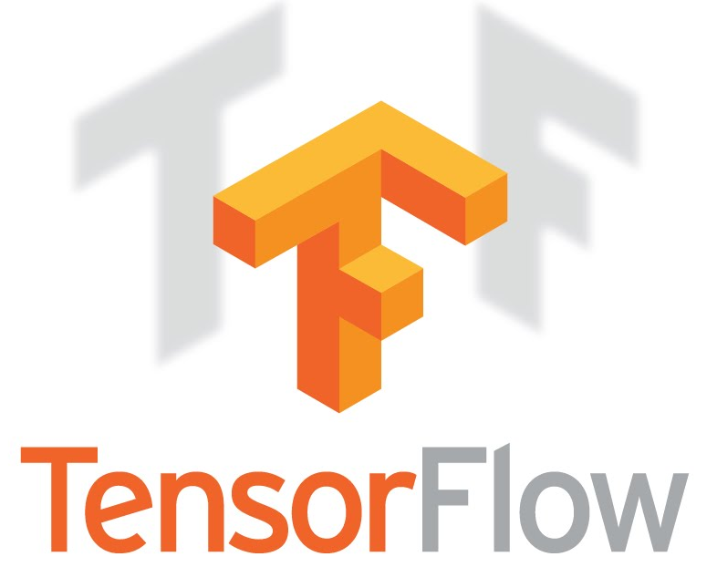
Open Source
Computer Cluster
Parameter Server
Federated Learning
Blockchain Compute Grid
Federated Learning
for Safe AI

